Slide 1
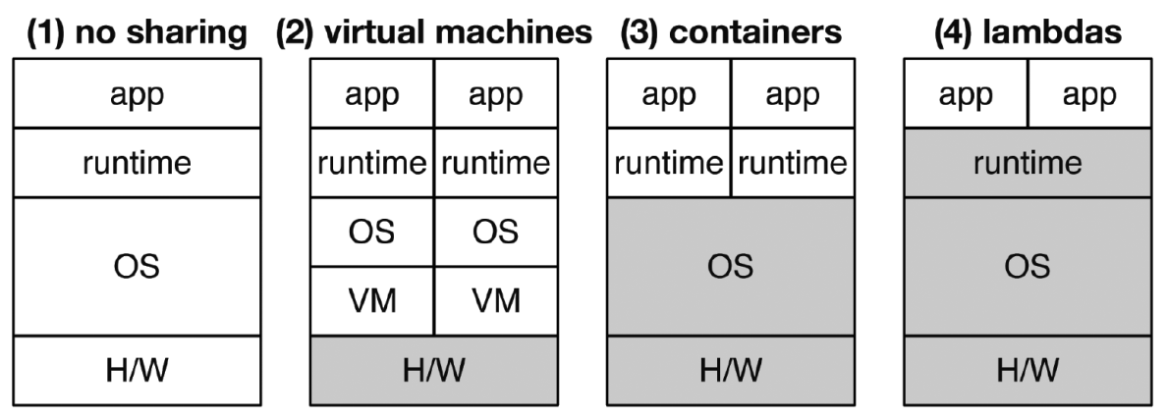
OpenLambda and Firecracker
https://bit.ly/4j7gV0V

